Slide 1

Capstone
PROJECT
PRESENTING BY
-THIYANESHWAR K

Slide 2

Table of
CONTENTS
01
02
03
04
INTRODUCTION
DATASET OVERVIEW
DATA PREPROCESSING
VISUALIZATION
05
06
07
08
MACHINE LEARNING ALGORITHMS USED
MODEL EVALUATION
AND PERFORMANCE COMPARISON
CHALLENGES IN THIS DATASET
CONCLUSION

Slide 3

INTRODUCTION
Online transaction frauds and detectors has performed a complex role for a long time . Transaction fraud is much more common than ever before,specifically in the Internet age and it results in significant financial losses. As a result, banks and financial service providers may be required to develop an automated online fraud detection system to detect and monitor online transactions. Fraud detection systems are meant to discover and tack incoming transactions by separating anomalous activity patterns from a large number of transactional records.
Machine learning has proven to be extremely effective at identifying these patterns. Alternatively, a large number of transaction records could be utilized to train a high- performing fraud classifier. Despite the fact that supervised learning has proven to be incredibly effective in detecting fraudulent transactions, transactional fraud analysis technology will continue to progress. Small Improvements might also save a lot of money for a peoples, banking systems and companies .

Slide 4
DATASET OVERVIEW
About Dataset:
There are 6362620 rows and 11 columns in our dataset.
step : represents a unit of time where 1 step equals 1 hour
type : type of online transaction amount : the amount of the transaction nameOrig : customer starting the transaction
oldbalanceOrg : balance before the transaction
newbalanceOrig : balance after the transaction
nameDest : recipient of the transaction
oldbalanceDest : initial balance of recipient before the transaction
newbalanceDest : the new balance of recipient after the transaction
isFraud : fraud transaction
isFlaggedFraud : Assumation has been flagged fraud transaction

Slide 5
PROBLEM STATEMENT:
Online payment fraud detection is a common problem that businesses face when processing payments online. The goal is to detect fraudulent transactions before they are processed and approved, In order to prevent financial losses and protect the business and its customers.
One approach to tackle this problem is:
Transaction Monitoring:
This involves using machine learning algorithms to analyze transactions in real-time, looking for patterns or anomalies that may indicate fraud. For example, a sudden increase in the number of transactions or a change in transaction patterns may indicate fraudulent activity.
Hence, In order to identify online payment fraud with machine learning, we need to train a machine learning model for classifying fraudulent and non-fraudulent payments.

Slide 6
DATA PROCESSING
It refers to the manipulation and transformation of raw data into meaningful and useful information. It involves a series of operations that convert data into a more structured format, making it easier to analyze, interpret, and present. Data processing is a crucial step in the data lifecycle and is essential for extracting valuable insights from the data.
The process of data processing typically includes the following steps:
Importing the necessary packages
Loading the Dataset
About data in the Dataset
Handling null values
Handling Outliers
Handling Categorical Data
Balancing the Dataset
Feature Scaling
Split the dataset into training and testing sets

Slide 7
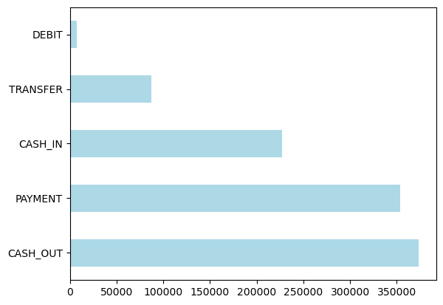
EXPLORATORY DATA ANALYSIS (EDA)
The plot shows that the "Cash Out" type has the highest frequency compared to other transactions types. This suggests that cash-out transactions are the most common or significant in the given dataset.
The second-highest frequency is associated with the "Payment" type. It indicates that payments made through the specified method rank second in terms of occurrence or total value. The plot also includes other payment types, but they appear to have lower frequencies or amounts compared to Cash Out and Payment. These payment types could include things like "Cash-IN," "Transfer," and "DEBIT".

Slide 8
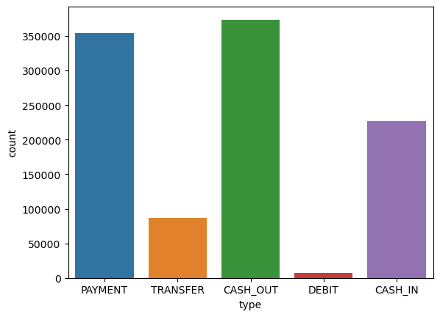
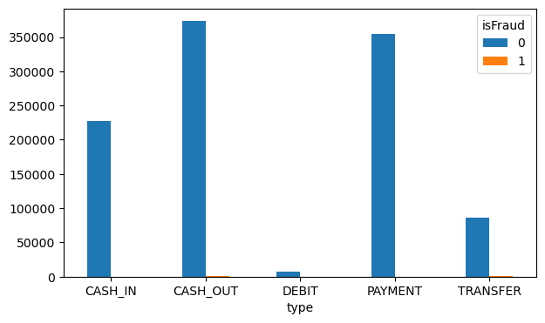
Thee count plot is a useful way to get an overview of the different transaction types and their frequencies in the dataset amd By this graph we could understand the cash-out has high amount of Transaction and followed by Payment , Cash-in and Transfer
The bar plot shows the frequency of fraud occurrences for each transaction type.High Fraud in Cash-out and Transfer:
The two highest bars on the plot correspond to Cash-out and Transfer transaction types, indicating that these two categories have a higher frequency of fraud compared to other types.Comparison of Fraud Rates: By observing the heights of the bars, we can compare the relative fraud rates between different transaction types. It is evident that Cash-out and Transfer have significantly higher fraud rates than other types in the dataset.Potential Risk Categories: Cash-out and Transfer transactions are highlighted as potential risk categories for fraudulent activities. If you are looking to detect and prevent fraud, these two transaction types might require more focused attention and scrutiny

Slide 9
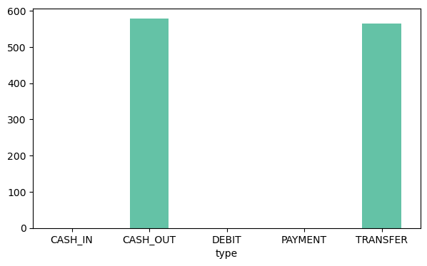
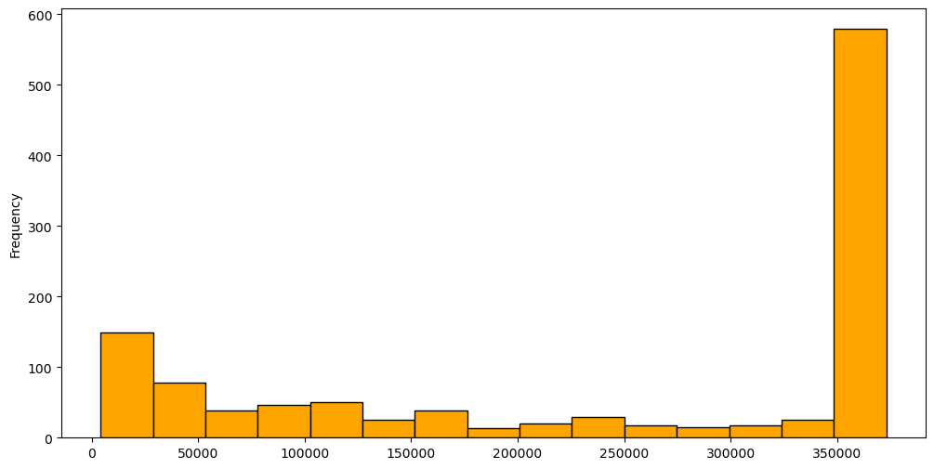
By bar-graph we could clearly see there is occurance of fraud only in the Cash-out and Transfer type and also have count of the fraud occurances
We've found that fraud amount transaction ranges between 1.3-3.6 lakh.
Now, we can see that among them most occured were around 340,000-360,000
(3.4-3.6 lakh).

Slide 10
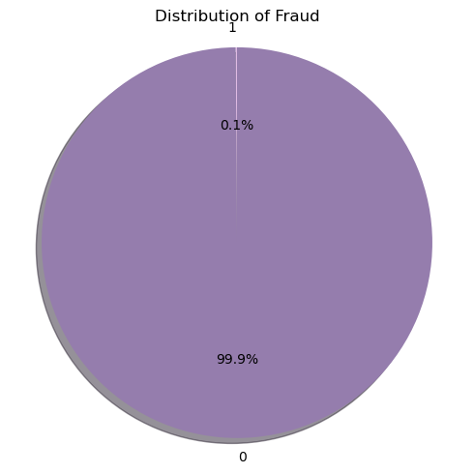
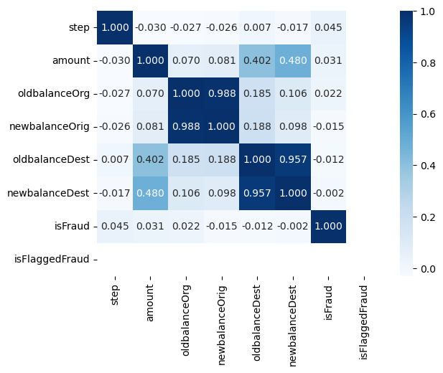
The resulting pie chart provides an overview of the class distribution in the credit card fraud dataset. Each slice represents a class ('Fraud' or 'Non-Fraud'), and its size corresponds to the proportion of that class in the dataset. The percentage values displayed within each slice indicate the relative occurrence of each class.It takes value 1 in case of fraud and 0 not fraud.
which means fraud is 0.1% and not fraud is 99.9% .
There is a high correlation between newbalanceOrig and oldbalanceOrg.
Also, between newbalanceDest and oldbalanceDest.
Apart from that, we have a relatively high correlation between amount and newbalanceDest and amount with oldbalanceDest.

Slide 11
MACHINE LEARNING ALGORITHMS USED
LOGISTICS REGRESSION
KNNCLASSIFIER
SUPPORT VECTOR MACHINE
DECISION TREE
RANDOM FOREST
ADABOOST
XGBOOST

Slide 12
MODEL EVALUATION
AND PERFORMANCE COMPARISON
Training Model SVC
--------------
Training Accuracy: 0.9113300492610837
Testing Accuracy: 0.49671772428884026
Testing Confusion Matrix:
[[ 0 230]
[ 0 227]]
Recall Score : 0.49671772428884026
Precision Score : 0.49671772428884026
Testing F-1: 0.49671772428884026
Testing F-Beta: 0.49671772428884026
------------------------------
Training Model Ada Boost
--------------
Training Accuracy: 0.9638752052545156
Testing Accuracy: 0.5032822757111597
Testing Confusion Matrix:
[[230 0]
[227 0]]
Recall Score : 0.5032822757111597
Precision Score : 0.5032822757111597
Testing F-1: 0.5032822757111597
Testing F-Beta: 0.5032822757111597
------------------------------
Training Model XGBoost
--------------
Training Accuracy: 1.0
Testing Accuracy: 0.5010940919037199
Testing Confusion Matrix:
[[229 1]
[227 0]]
Recall Score : 0.5010940919037199
Precision Score : 0.5010940919037199
Testing F-1: 0.5010940919037199
Testing F-Beta: 0.5010940919037199
------------------------------
Training Model Decision Tree
--------------
Training Accuracy: 1.0
Testing Accuracy: 0.5010940919037199
Testing Confusion Matrix:
[[229 1]
[227 0]]
Recall Score : 0.5010940919037199
Precision Score : 0.5010940919037199
Testing F-1: 0.5010940919037199
Testing F-Beta: 0.5010940919037199
------------------------------
Training Model Random Forest
--------------
Training Accuracy: 1.0
Testing Accuracy: 0.2910284463894967
Testing Confusion Matrix:
[[132 98]
[226 1]]
Recall Score : 0.2910284463894967
Precision Score : 0.2910284463894967
Testing F-1: 0.2910284463894967
Testing F-Beta: 0.2910284463894967
------------------------------
Training Model SVC
--------------
Training Accuracy: 0.9113300492610837
Testing Accuracy: 0.49671772428884026
Testing Confusion Matrix:
[[ 0 230]
[ 0 227]]
Recall Score : 0.49671772428884026
Precision Score : 0.49671772428884026
Testing F-1: 0.49671772428884026
Testing F-Beta: 0.49671772428884026
------------------------------
Training Model Ada Boost
--------------
Training Accuracy: 0.9638752052545156
Testing Accuracy: 0.5032822757111597
Testing Confusion Matrix:
[[230 0]
[227 0]]
Recall Score : 0.5032822757111597
Precision Score : 0.5032822757111597
Testing F-1: 0.5032822757111597
Testing F-Beta: 0.5032822757111597
------------------------------
Training Model XGBoost
--------------
Training Accuracy: 1.0
Testing Accuracy: 0.5010940919037199
Testing Confusion Matrix:
[[229 1]
[227 0]]
Recall Score : 0.5010940919037199
Precision Score : 0.5010940919037199
Testing F-1: 0.5010940919037199
Testing F-Beta: 0.5010940919037199
------------------------------
Training Model Logistic Regression
--------------
Training Accuracy: 0.8801313628899836
Testing Accuracy: 0.7396061269146609
Testing Confusion Matrix:
[[115 115]
[ 4 223]]
Recall Score : 0.7396061269146609
Precision Score : 0.7396061269146609
Testing F-1: 0.7396061269146609
Testing F-Beta: 0.7396061269146609
------------------------------
Training Model KNN
--------------
Training Accuracy: 0.9293924466338259
Testing Accuracy: 0.49671772428884026
Testing Confusion Matrix:
[[ 0 230]
[ 0 227]]
Recall Score : 0.49671772428884026
Precision Score : 0.49671772428884026
Testing F-1: 0.49671772428884026
Testing F-Beta: 0.49671772428884026
------------------------------
Training Model Decision Tree
--------------
Training Accuracy: 1.0
Testing Accuracy: 0.5010940919037199
Testing Confusion Matrix:
[[229 1]
[227 0]]
Recall Score : 0.5010940919037199
Precision Score : 0.5010940919037199
Testing F-1: 0.5010940919037199
Testing F-Beta: 0.5010940919037199
------------------------------
Training Model Random Forest
--------------
Training Accuracy: 1.0
Testing Accuracy: 0.2910284463894967
Testing Confusion Matrix:
[[132 98]
[226 1]]
Recall Score : 0.2910284463894967
Precision Score : 0.2910284463894967
Testing F-1: 0.2910284463894967
Testing F-Beta: 0.2910284463894967
------------------------------
Training Model SVC
--------------
Training Accuracy: 0.9113300492610837
Testing Accuracy: 0.49671772428884026
Testing Confusion Matrix:
[[ 0 230]
[ 0 227]]
Recall Score : 0.49671772428884026
Precision Score : 0.49671772428884026
Testing F-1: 0.49671772428884026
Testing F-Beta: 0.49671772428884026
------------------------------
Training Model Ada Boost
--------------
Training Accuracy: 0.9638752052545156
Testing Accuracy: 0.5032822757111597
Testing Confusion Matrix:
[[230 0]
[227 0]]
Recall Score : 0.5032822757111597
Precision Score : 0.5032822757111597
Testing F-1: 0.5032822757111597
Testing F-Beta: 0.5032822757111597
------------------------------
Training Model XGBoost
--------------
Training Accuracy: 1.0
Testing Accuracy: 0.5010940919037199
Testing Confusion Matrix:
[[229 1]
[227 0]]
Recall Score : 0.5010940919037199
Precision Score : 0.5010940919037199
Testing F-1: 0.5010940919037199
Testing F-Beta: 0.5010940919037199
------------------------------

Slide 13
CHALLENGES IN THIS DATASET
Unbalanced Dataset
Handling with Null values
Data Bias
Feature Scaling
Redundant Entries

Slide 14
CONCLUSION
Dataset Overview: The dataset contains 6,362,620 rows and 11 columns. Each row represents a transaction, and the columns represent various attributes of the transactions, such as time, transaction type, transaction amount, customer information, and recipient information. The target variable is isFraud, which indicates whether a transaction is fraudulent (1) or not (0).
Features: The dataset includes features such as step, type, amount, nameOrig, oldbalanceOrg, newbalanceOrig, nameDest, oldbalanceDest, newbalanceDest, isFraud, and isFlaggedFraud.
Target Variable: The primary task is to predict whether a transaction is fraudulent (isFraud = 1) or not (isFraud = 0). This is a binary classification problem.
Fraud Detection: The goal is to develop a machine learning model that can effectively detect fraudulent transactions to prevent financial losses and protect customers and businesses.
Best Algorithm: According to the inference made from the provided code, the Random Forest classifier achieved the highest AUC score among all the classifiers evaluated. A higher AUC score indicates better performance in distinguishing between fraudulent and non-fraudulent transactions. Therefore, it can be concluded that the Random Forest algorithm is the best-performing model for this specific dataset and task of online payment fraud detection.
However, it's important to note that the choice of the "best" algorithm may depend on various factors, including data size, data quality, feature engineering, and specific performance metrics. Therefore, it's always recommended to perform thorough model evaluation and hyperparameter tuning to ensure the most suitable algorithm for a given problem. Additionally, you may want to explore other machine learning algorithms and techniques to further improve the model's performance.

